Slide 1

Session-based
Recommendation with Graph Neural Networks
GNN Study Group - Irene

Slide 2
01.
談談推薦系統
02.
你需要先知道的演算法知識
03.
論文提出的模型
04.
EXPERIMENTAL
05.
CONCLUSION
常見的推薦系統做法
Session Based Recommendation
RNN & LSTM & GRU
GNN & GGNN
2.1 建立 Session Based Graph
2.2 Item Embedding Learning by GNN
2.3 Session Embedding (hybrid Embedding：Local Preference & Global Interest )
2.4 生成推薦結果
Notes:
首先，我们代表用户当前的兴趣，也称作local embedding，以强调最后点击的项目的影响。再者，通过软注意力网络（soft-attention network）获得global embedding，来表示全局偏好。 和 控制权重

Slide 3
01
談談推薦系統

Slide 4

常見的推薦系統做法

Slide 5
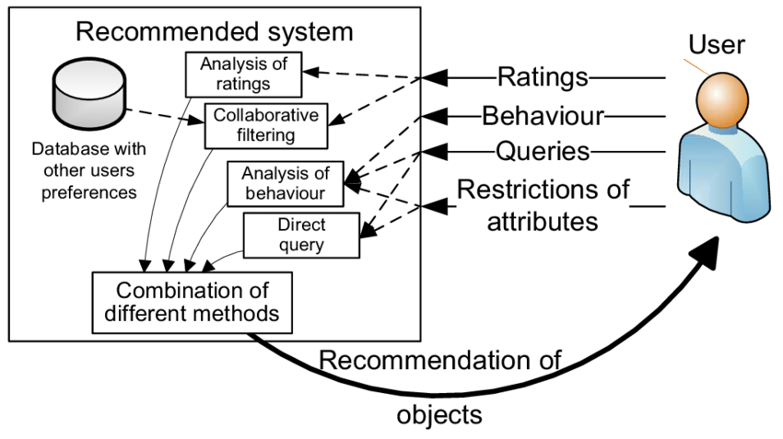
這些常見的推薦系統做法通常都需要許多歷史數據

Slide 6
Session Based Recommendation
大多數學術研究都關注根據長期用戶數據進行個性化推薦的方法。然而，在許多現實世界的應用中，這種文件不會長期保存，而且用戶的興趣是動態變化的，因此必須僅基於用戶在正在進行的 Session 對系統做出推薦。

Slide 7
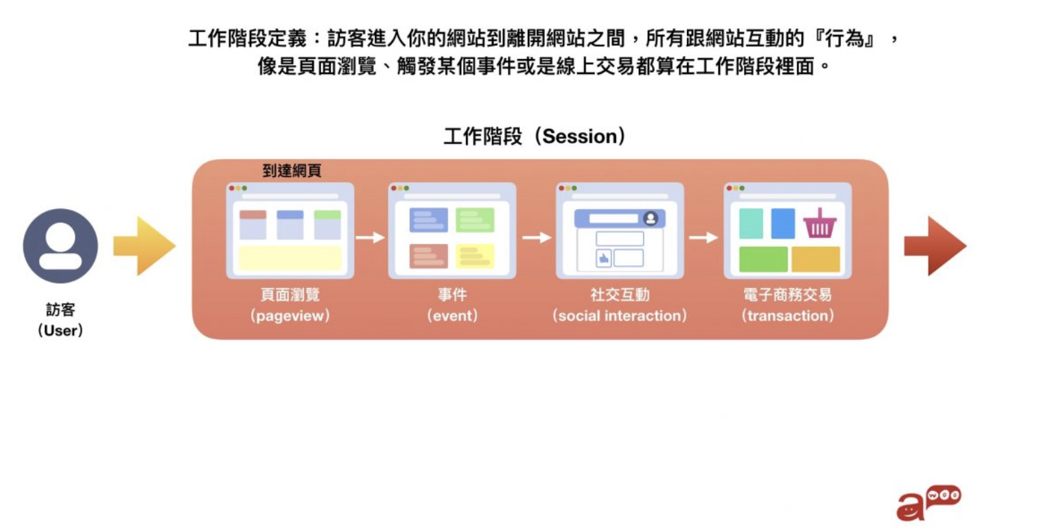
快速解釋 session 是什麼

Slide 8
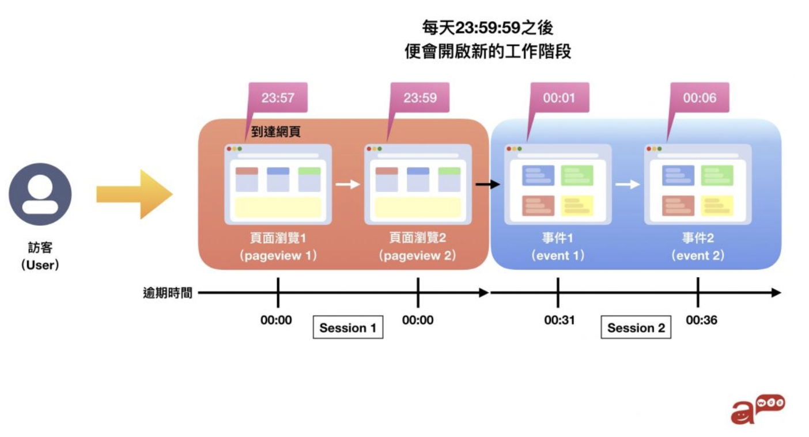
快速解釋 session 是什麼

Slide 9
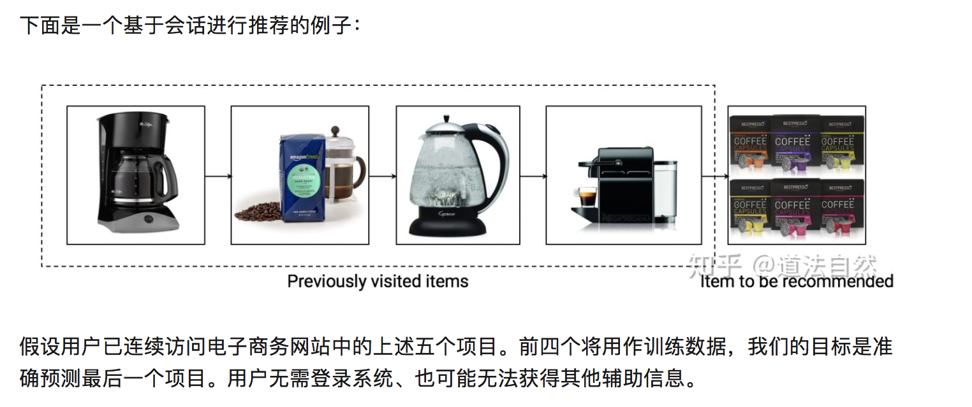
這篇論文要解決什麼問題

Slide 10
02
你需要先知道的
演算法知識

Slide 11

RNN
X：每個時間點的數據 (input)
H：hidden state (output)
A：RNN Unit (Model)

Slide 12
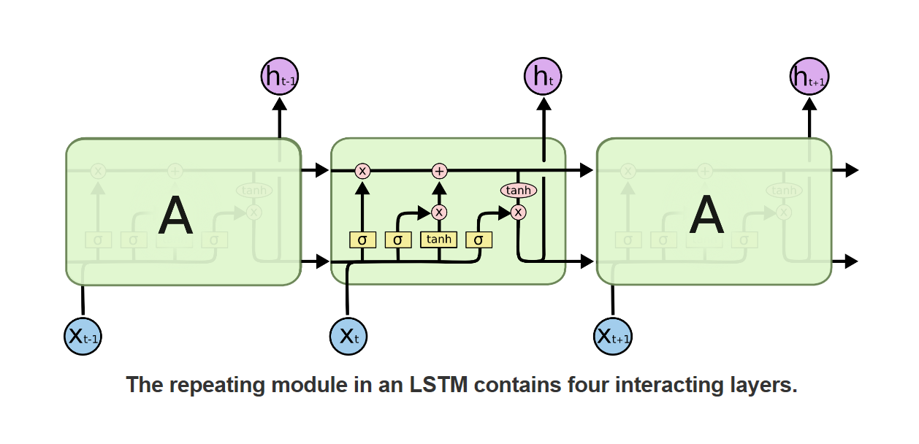
兩個 input
A多了三個Gated:input,output,forget
X, ht-1 ,Bias 會copy 4次
LSTM
Cell state(為了處理長期記憶)
跟原本 RNN 一樣的hidden state

Slide 13
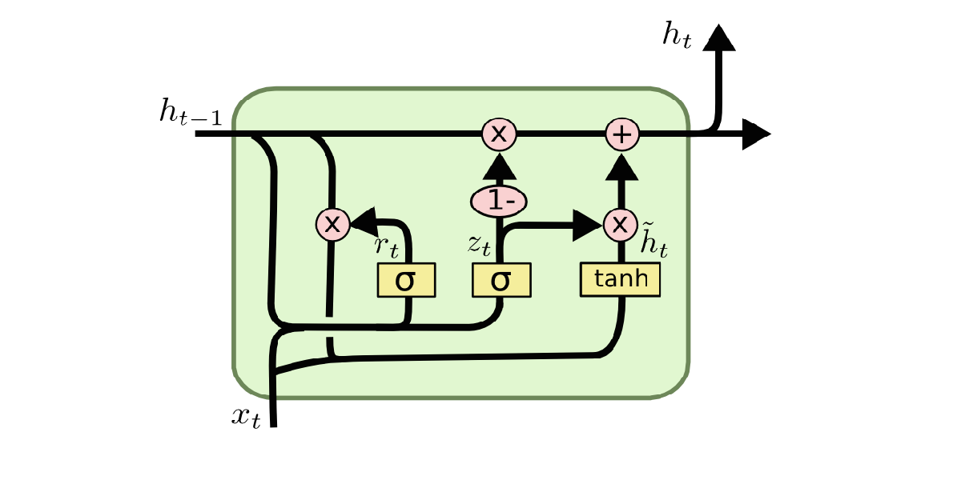
GRU
優勢：減少計算量但效果跟LSTM 一樣好
Reset gate
update gate
Input+forget ->Reset Gate
Input+output ->Update Gate

Slide 14
RNN & LSTM & GRU
 | RNN | LSTM | GRU
優勢 | 時間序列NN的基礎，但會隨著時間傳遞愈遠的資料會愈容易被淡忘 | 加入長期記憶 | 效能優化
Gate |  | Forget/Input/Output | Reset/Update 所以少了一個Gate、減少計算量 Reset : input + output Update : input + output
傳遞 | Hidden State | Cell State (長期記憶處理) Hidden State | Hidden State

Slide 15
GNN & GGNN
 | GNN 提出於 [Scarselli et al. 2009] | GGNN [Li et al. 2016]
 |  | 加入GRU GGNN : 今天天氣真好-> 今天天氣真好->今天天氣真好 RNN：今->天->天->氣->真->好
iteration | 通過 Almeida-Pineda 算法訓練模型 (到一個門檻才更新梯度) | 通過 BPTT 計算梯度 (每次更新)
輸出 | Node embedding

Slide 16
03
論文提出的模型

Slide 17
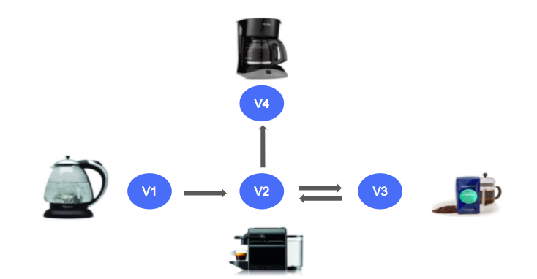

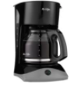


白話文解釋論文提出的模型
1. 建立多個 Session Graph
2. 利用 GGNN 做出每個品項的 vector
3. 充分考慮 Global 和 Local 的興趣表達 Session Vector
{f1, f2, f3, f4, f5, f6……….}
Global 興趣
{f1, f2, f3, f4, f5, f6……….}
Node Embedding
Local 興趣
其他session graph
Session Embedding
4. 生成推薦結果
Session Embedding 和 所有 Session 涵蓋的品項相乘，計算得分
得分愈高的品項就會被推薦到該 Session

Slide 18
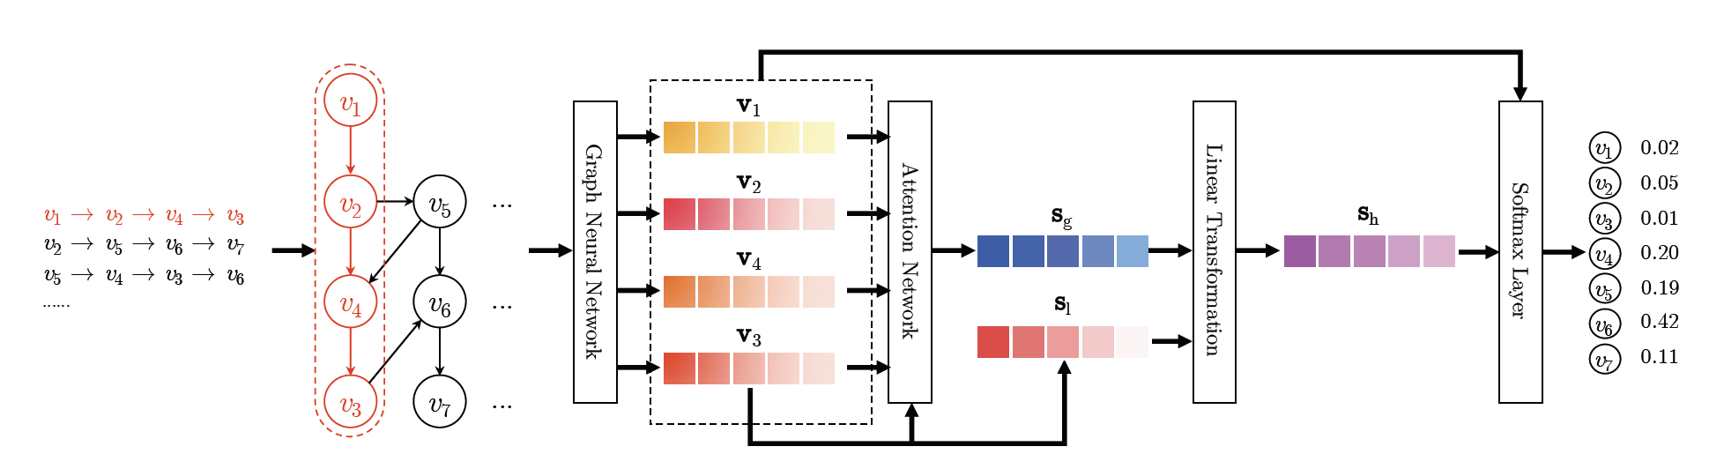
論文提出的模型
1
2
3
4
Step1. Constructing Session Graph
Step2. Item Embedding Learning by GGNN
Step3. Session Embedding (hybrid Embedding：Local Preference & Global Interest )
Step4. 生成推薦結果

Slide 19
Step 1 ：Constructing Session Graph
V4
V1
V2
V3

Slide 20
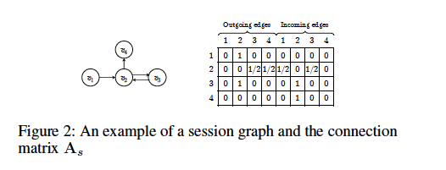
Step 2-1. Item Embedding Learning by GGNN
舉例：咖啡機(v2) 有 2 個 outdegree
v2 對 v3 ： 1 (有 out 關係) / 總共 2 個 outdegree
v2 對 v4 ： 1 (有 out 關係) / 總共 2 個 outdegree

Slide 21
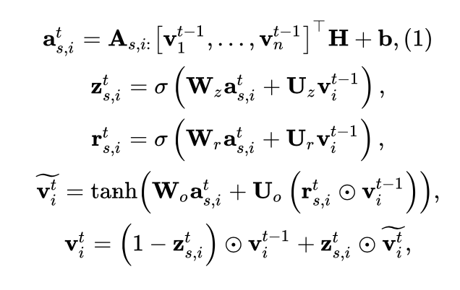
Step 2-2. Item Embedding Learning by GGNN
Connection Matrix
Update gate
Reset gate

Slide 22
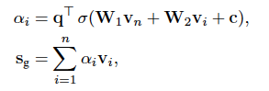
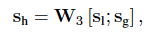
Step3. Session Embedding (hybrid Embedding：Local Preference & Global Interest )
To better predict the users’ next clicks, we plan to develop a strategy to combine long-term preference and current interests of the session, and use this combined embedding as the session embedding.
Local Preference ：Can be simply defined as vn of the last-clicked item
Global Interest ：we further adopt the soft-attention mechanism to better represent the global session preference
Hybrid embedding ：Finally, we compute the hybrid embedding sh by taking linear transformation over the concatenation of the local and global embedding vectors
Hybrid: (local concat global )*Weight = session embedding

Slide 23
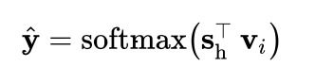
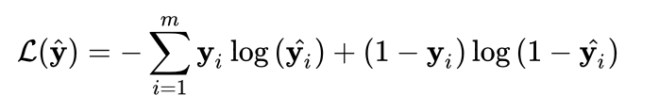
Step4. 生成推薦結果
推薦分數計算：
全部使用到的 session 的 node list (所有品項)
For each session graph, the loss function is defined as the cross-entropy of the prediction and the ground truth. It can be written as follows ：

Slide 24
04
Experimental

Slide 25
Dataset
The Yoochoose dataset is obtained from the RecSys Challenge 2015, which contains a stream of user clicks on an e-commerce website within 6 months.
The Diginetica dataset comes from CIKM Cup 2016, where only its transactional data is used.

Slide 26
Baseline
POP and S-POP
Item-KNN [Sarwar et al. 2001]
BPR-MF [Rendle et al. 2009]
FPMC [Rendle et al. 2010]
GRU4REC [Hidasi et al. 2016]
NARM [Li et al. 2017a]
STAMP [Liu et al. 2018]

Slide 27
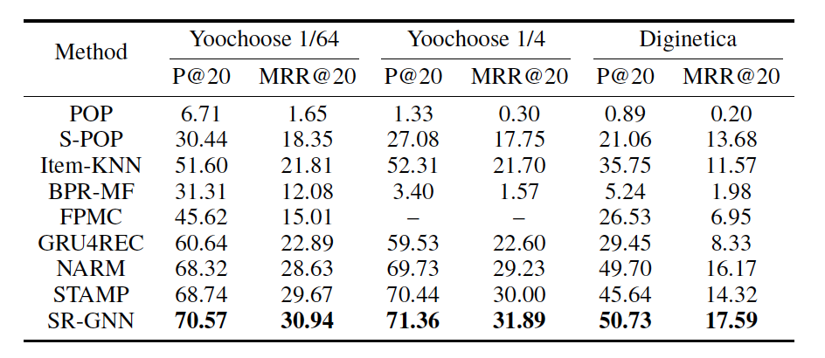
Comparison with Baseline
Notes:
• P@20 (Precision) is widely used as a measure of predictive
accuracy. It represents the proportion of correctly recommended
items amongst the top-20 items.
• MRR@20 (Mean Reciprocal Rank) is the average of reciprocal
ranks of the correctly-recommended items. The
reciprocal rank is set to 0 when the rank exceeds 20.
The MRR measure considers the order of recommendation
ranking, where large MRR value indicates that correct
recommendations in the top of the ranking list.

Slide 28
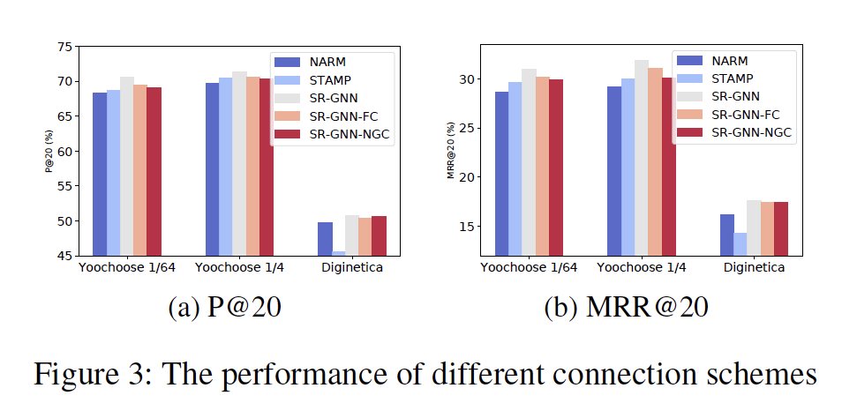
Comparison with Variants of Connection Schemes
• SR-GNN with normalized global connections (SR-GNNNGC) replaces the connection matrix with edge weights extracted from the global graph on the basis of SR-GNN.
• SR-GNN with full connections (SR-GNN-FC) represents all higher-order relationships using boolean weights and appends its corresponding connection matrix to that of SR-GNN.

Slide 29
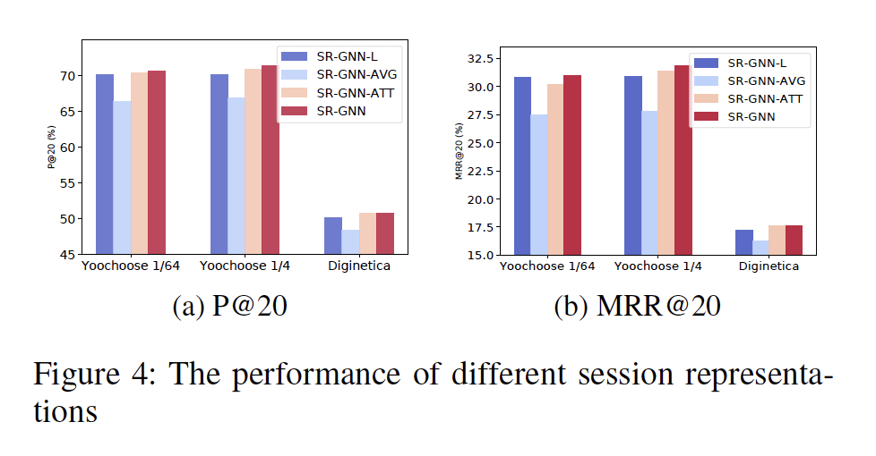
Comparison with Different Session Embeddings
(1) local embedding only (SR-GNNL),
(2) global embedding with average pooling (SR-GNNAVG)
(3) global embedding with the attention mechanism (SR-GNN-ATT).

Slide 30
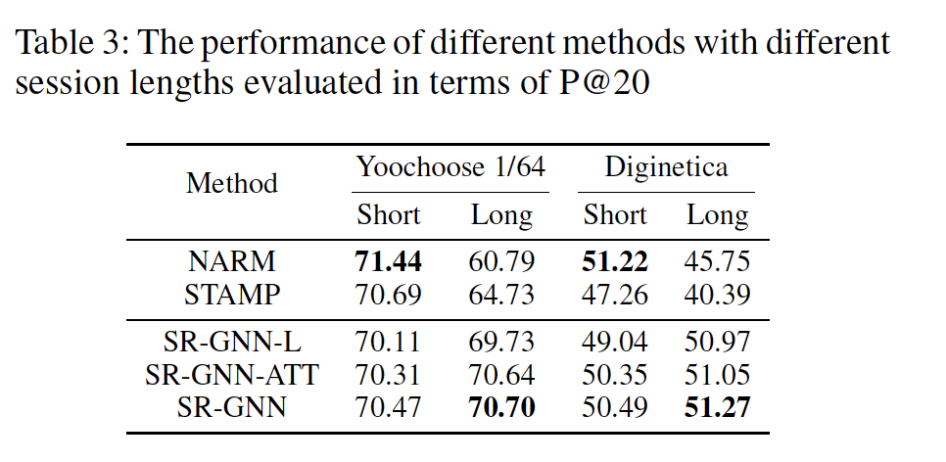
Analysis on Session Sequence Lengths
we partition sessions of Yoochoose 1/64 and Diginetica into two groups, where “Short” indicates that the length of sessions is less than or equal to 5, while each session has more than 5 items in “Long”.

Slide 31
05
Conclusion

Slide 32
論文結論
在難以獲得用戶偏好和歷史記錄的情況下，Session Based Recommendation 是必不可少的。
作者提出了一種基於 Session Based Recommendation 的新穎架構，它將 GNN 結合到表示 Session 序列中。
所提出的方法不僅考慮了 Session 序列項之間的複雜結構和轉換，而且還開發了一種策略，將 Global Preference 和 Local Interest 相結合，以更好地預測用戶的下一步行為。
綜合實驗證實，所提出的算法可以始終優於其他最先進的方法。

Slide 33

THANKS!
Do you have any questions?
Irene Chen

